Slide 1
Operating system
Storage management

Slide 2
About
To make the computer system convenient for users, the operating system provides a uniform, logical view of information storage.
The operating system abstracts from the physical properties of its storage devices to define a logical storage unit, the file.
The operating system maps files onto physical media and accesses these files via the storage devices.

Slide 3
File-System Management
File management is one of the most visible components of an operating system.
Computers can store information on several different types of physical media.
Magnetic disk, optical disk, and magnetic tape are the most common.
Each of these media has its own characteristics and physical organization.
Each medium is controlled by a device, such as a disk drive or tape drive, that also has its own unique characteristics.
These properties include access speed, capacity, data-transfer rate, and access method (sequential or random).

Slide 4
The operating system is responsible for the following activities in connection with file management:
Creating and deleting files
Creating and deleting directories to organize files
Supporting primitives for manipulating files and directories
Mapping files onto secondary storage
Backing up files on stable (nonvolatile) storage media

Slide 5
Mass-Storage Management
main memory is too small to accommodate all data and programs, and because the data that it holds are lost when power is lost, the computer system must provide secondary storage to back up main memory.
the proper management of disk storage is of central importance to a computer system.

Slide 6
The operating system is responsible for the following activities in connection with disk management:
• Free-space management
• Storage allocation
• Disk scheduling

Slide 7
Caching
Caching is an important principle of computer systems.
Information is normally kept in some storage system (such as main memory).
As it is used, it is copied into a faster storage system—the cache—on a temporary basis. When we need a particular piece of information, we first check whether it is in the cache.
If it is, we use the information directly from the cache. If it is not, we use the information from the source, putting a copy in the cache under the assumption that we will need it again soon.
The programmer (or compiler) implements the register-allocation and register-replacement algorithms to decide which information to keep in registers and which to keep in main memory

Slide 8
cache management
caches have limited size, cache management is an important design problem. Careful selection of the cache size and of a replacement policy can result in greatly increased performance.
Cache is a type of memory that is used to increase the speed of data access.

Slide 9
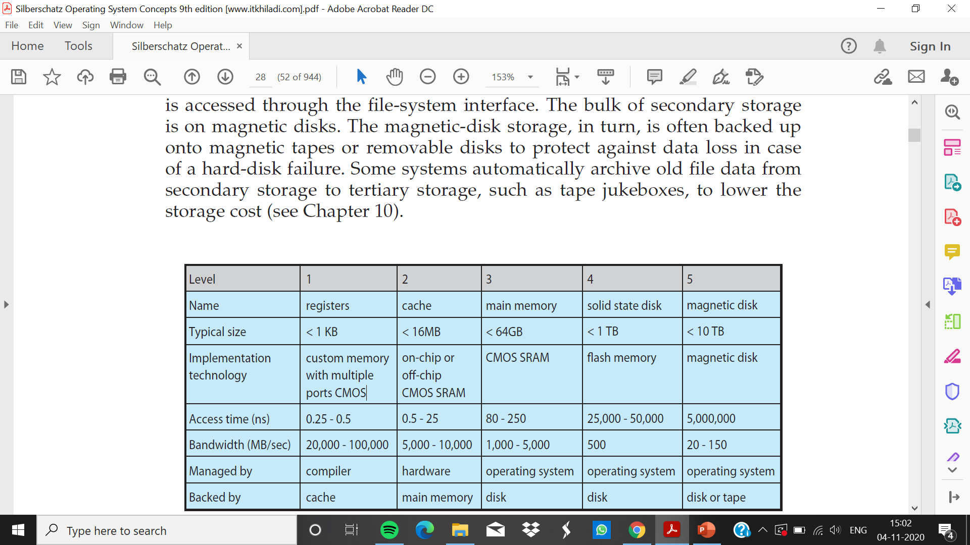

Slide 10
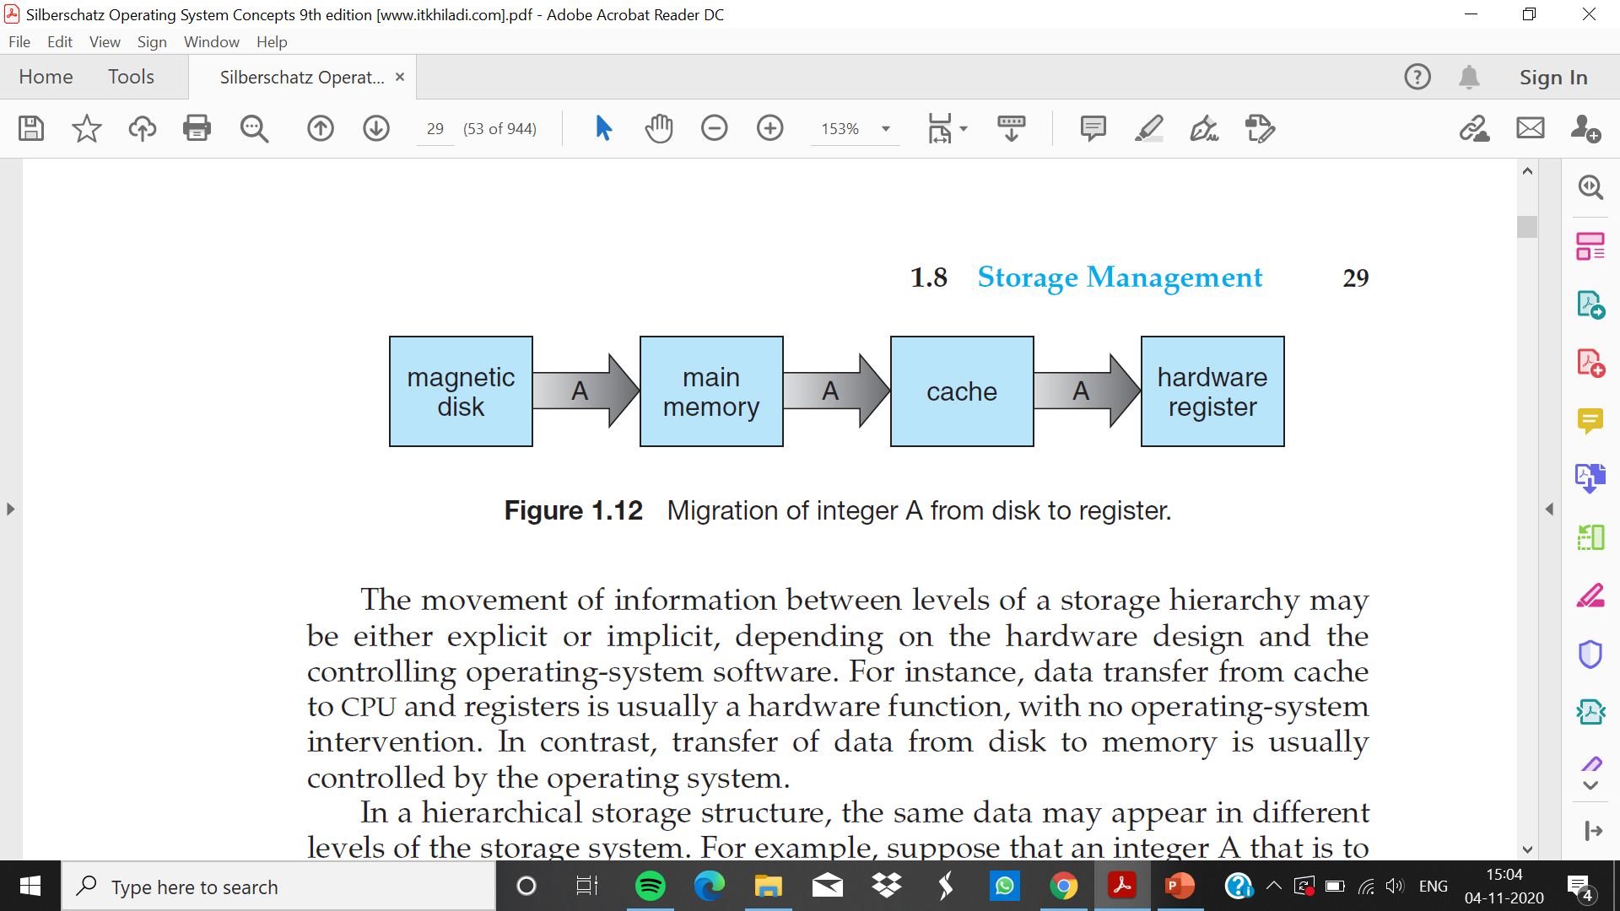

Slide 11
cache coherency
The Cache Coherence Problem is the challenge of keeping multiple local caches synchronized when one of the processors updates its local copy of data which is shared among multiple caches.

Slide 12
I/O Systems
The I/O subsystem consists of several components:
• A memory-management component that includes buffering, caching, and spooling
• A general device-driver interface
• Drivers for specific hardware devices

